Slide 1
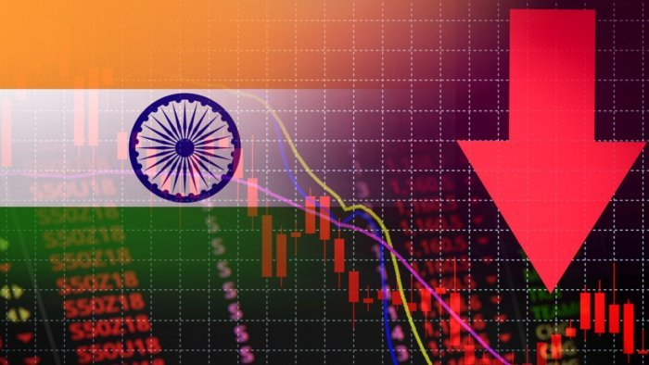
A STUDY ON THE IMPACT OF COVID-19 ON VARIOUS SECTORS OF THE INDIAN MARKETS
RONAK SHAH
PF2022-2089

Slide 2









INTRODUCTION
RESEARCH METHODOLOGY
SECTORS OF NIFTY
TABLE OF
CONTENTS
ANALYSIS & INTERPRETATIONS
PROJECT OBJECTIVES
LIMITATIONS
RECOMMENDATIONS

Slide 3

INTRODUCTION
Cross Country Lockdown
Identification of Covid-19
Drop in NIFTY
New Demat Accounts

Slide 4
SECTORS OF NIFTY
Bank
IT
Realty
Infra
Energy
FMCG
Pharma
Auto
Fin Serv
Metal
Media

Slide 5
PROJECT OBJECTIVES
Changes in equity markets of India due to COVID-19
The repercussions of pandemic situation
Market capitalization correlation
Make concrete and justifiable conclusions & recommendations

Slide 6
RESEARCH METHODOLOGY
Estimation Model
Event Window
Model Specification
Sample
Data
Research Design

Slide 7
ANALYSIS & INTERPRETATIONS
1. NIFTY IT
5. NIFTY METAL
2. NIFTY PHARMA
4. NIFTY FIN SERV
3. NIFTY FMCG

Slide 8
ANALYSIS & INTERPRETATIONS
NIFTY INFRA
11
6
NIFTY BANK
NIFTY ENERGY
10
7
NIFTY REALTY
NIFTY MEDIA
9
8
NIFTY AUTO

Slide 9
LIMITATIONS
Sensitive Consequences
Relies on Assumptions
Arbitrary time span
Subjectivity
Sensitivity of Event Studies

Slide 10
RECOMMENDATIONS
Indian securities exchanges benchmark
Provide Guidance
Cross-country examination
Wider Scope
Emerging Products

Slide 11


